Slide 1
Final Project Report
Team member: Kai Qian, Jiapeng Li, Jiachen Zhang

Slide 2
Intro of project
Implementing Genetic Algorithm and test it with Game of Life
We used Genetic Algorithm concept to develop our own algorithm to select and mutate
With given Random seed to multiple generate initial patterns using Game of Life schematics
These patterns will go through selection and mutation processes
Genetic algorithm will determine the best one within those patterns by comparing their generations and growth rate
The best pattern will be passed into Swing window application(UI) to run
The application will pause when the count of best pattern matched one in the console

Slide 3
Classes
Chromosome.java
Genotype.java
Phenotype.java
InitialPattern.java
Mutator.java
Selector.java
Profile.java
GeneticAlgorithm.java
LifeGame.java(UI)
World.java(UI)
Game.java(Modified)

Slide 4
How we design
We applied Genetic algorithm to design our own functions
Chromosome
will be 9-bits Integer. 4 bits for X-aixs, 4 bits for Y-axis and one bit for alive
Maximum for X-axis and Y-axis is 1000; alive bit: 1 is alive, 2 is dead
Ex. X-axis : 14, Y-axis: 38, alive =1 ------> 100380014
Genotype
Transform a String into List<Chromosome>
Has functions transfer list<chromosome> to list<integer> for mutator to process
Ex. “12 4, 34 100, ” ---> [100040012, 101000034]
Phenotype
Take a genotype object and transform it from List<Integer> into one String
Ex. [100040012, 101000034] ---> “12 4, 34 100, ”

Slide 5
How we design
We applied Genetic algorithm to design our own functions
Initial pattern
Take given seed from profile.java to generate random function
Use random function to generate a phenotype which has a string of points
Ex. “12 34, 45 23, 652 31,”
Profile
Store configuration data of project including a random seed, max running generation of GA and life game, and probability to control mutation.
Genetic Algorithm
Create initial population using InitialPattern class.
According to survival rate,select part of Initial population, transform them to genotype, then mutate, turn them back to phenotype, combining with survive population and pass to next algorithm generation.

Slide 6
How we design
We applied Genetic algorithm to design our own functions
Mutator
There will be two ways to mutate, change a bit of Chromosome, our add a new one.
Generate a random number moveNum. If moveNum less than a fix probability we set in the Profile, then it will mutate.
Another random number muteNum controls the mutate of X or Y. And the random numbers xr & yr, to control the mutate of ten digit or one digit.
The random number liveNum controls if the cell alive or died.
Then generate a random number to control whether add new cell or not.
Random number addNum will be 1 to 8, means eight directions for add new.
Like this: 812
7X3
654
Finally, add all chromosomes to a new list to generate the new pattern.

Slide 7
How we design
We applied Genetic algorithm to design our own functions
Selector
Select some of the patterns from the last generation via a probability we set in Profile..
FInd the patterns with more generations, if the generations are equal, we compare the growth rate to select it.
Finally, use getBest method to find the best pattern.

Slide 8
How we design
We applied Genetic algorithm to design our own functions
.hasCycle function(Added in Game.java)
Store living cells number of a running life game in a list,
Check whether repeating fragment exists. If repeating times larger than CYCLECHECK_NUM in Profile.java, cycle exists, return true.
cRun function(Added in Game.java)
A game life run function that check cycle. If a pattern fall in cycle, divide the return living generation number by 50.
growthRate function(modified in Game.java)
Calculate average growth rate between every two game life generation

Slide 9
How we design
We applied Genetic algorithm to design our own functions
World
Game of life rule included
Initial and draw grid
Take a pattern and run game of life
Called by lifegame.java
LifeGame
Create a Jframe window to show how the best pattern evolve
If count matched with one printed in the console, pause to proof we did find the best pattern!

Slide 10
System Design
Initial Population
Get Seed
Run life game
Code
Select
Genotype
Mutate
Yes
Generation < Max Generation
Decode
Phenotype
No
Get best individual
Start UI

Slide 11
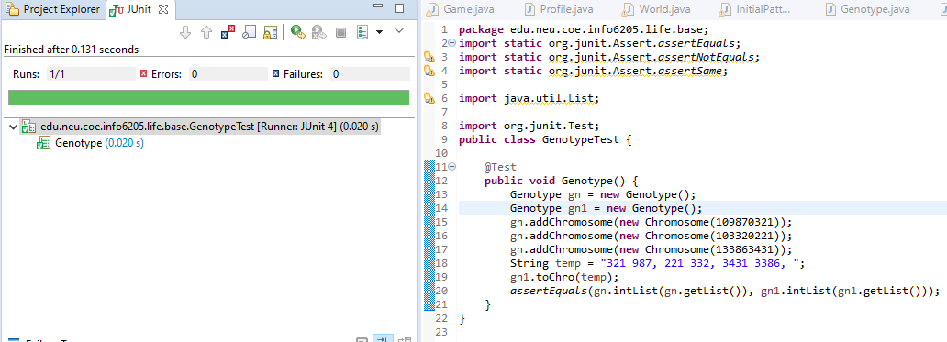
GenotypeTest

Slide 12
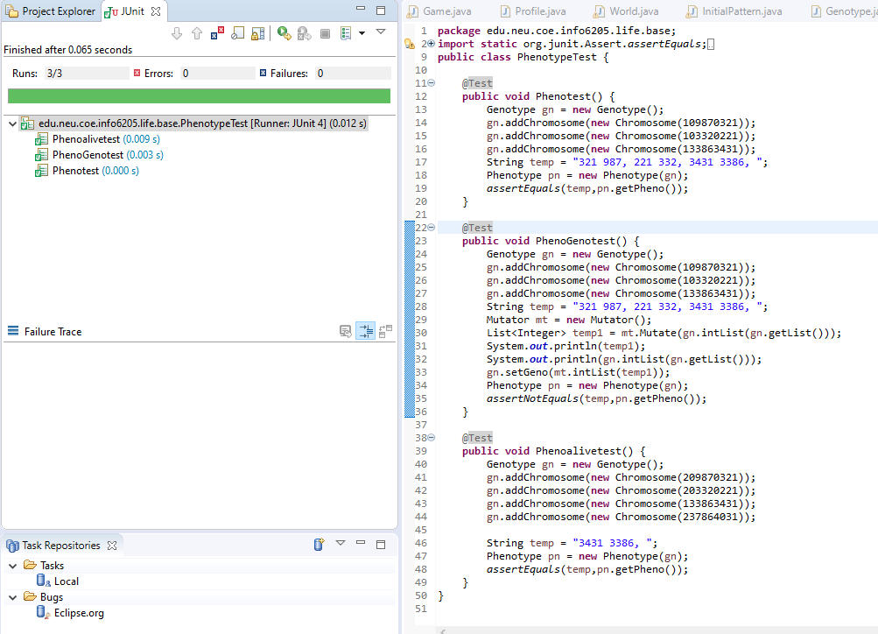
PhenotypeTest

Slide 13
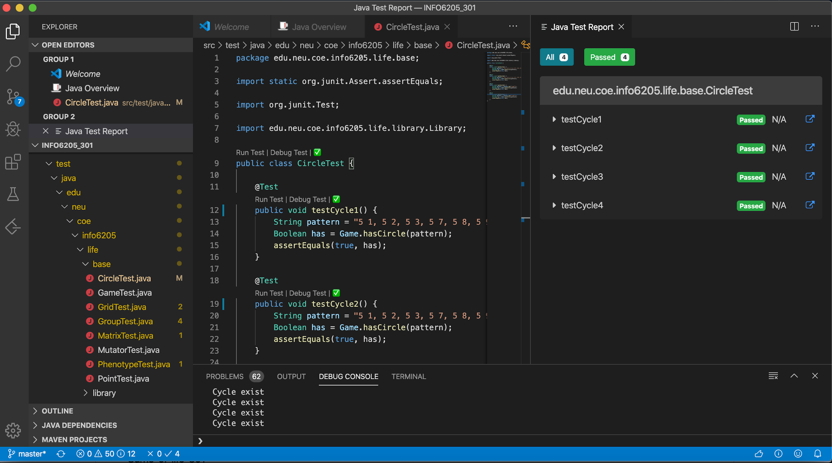
CycleTest

Slide 14
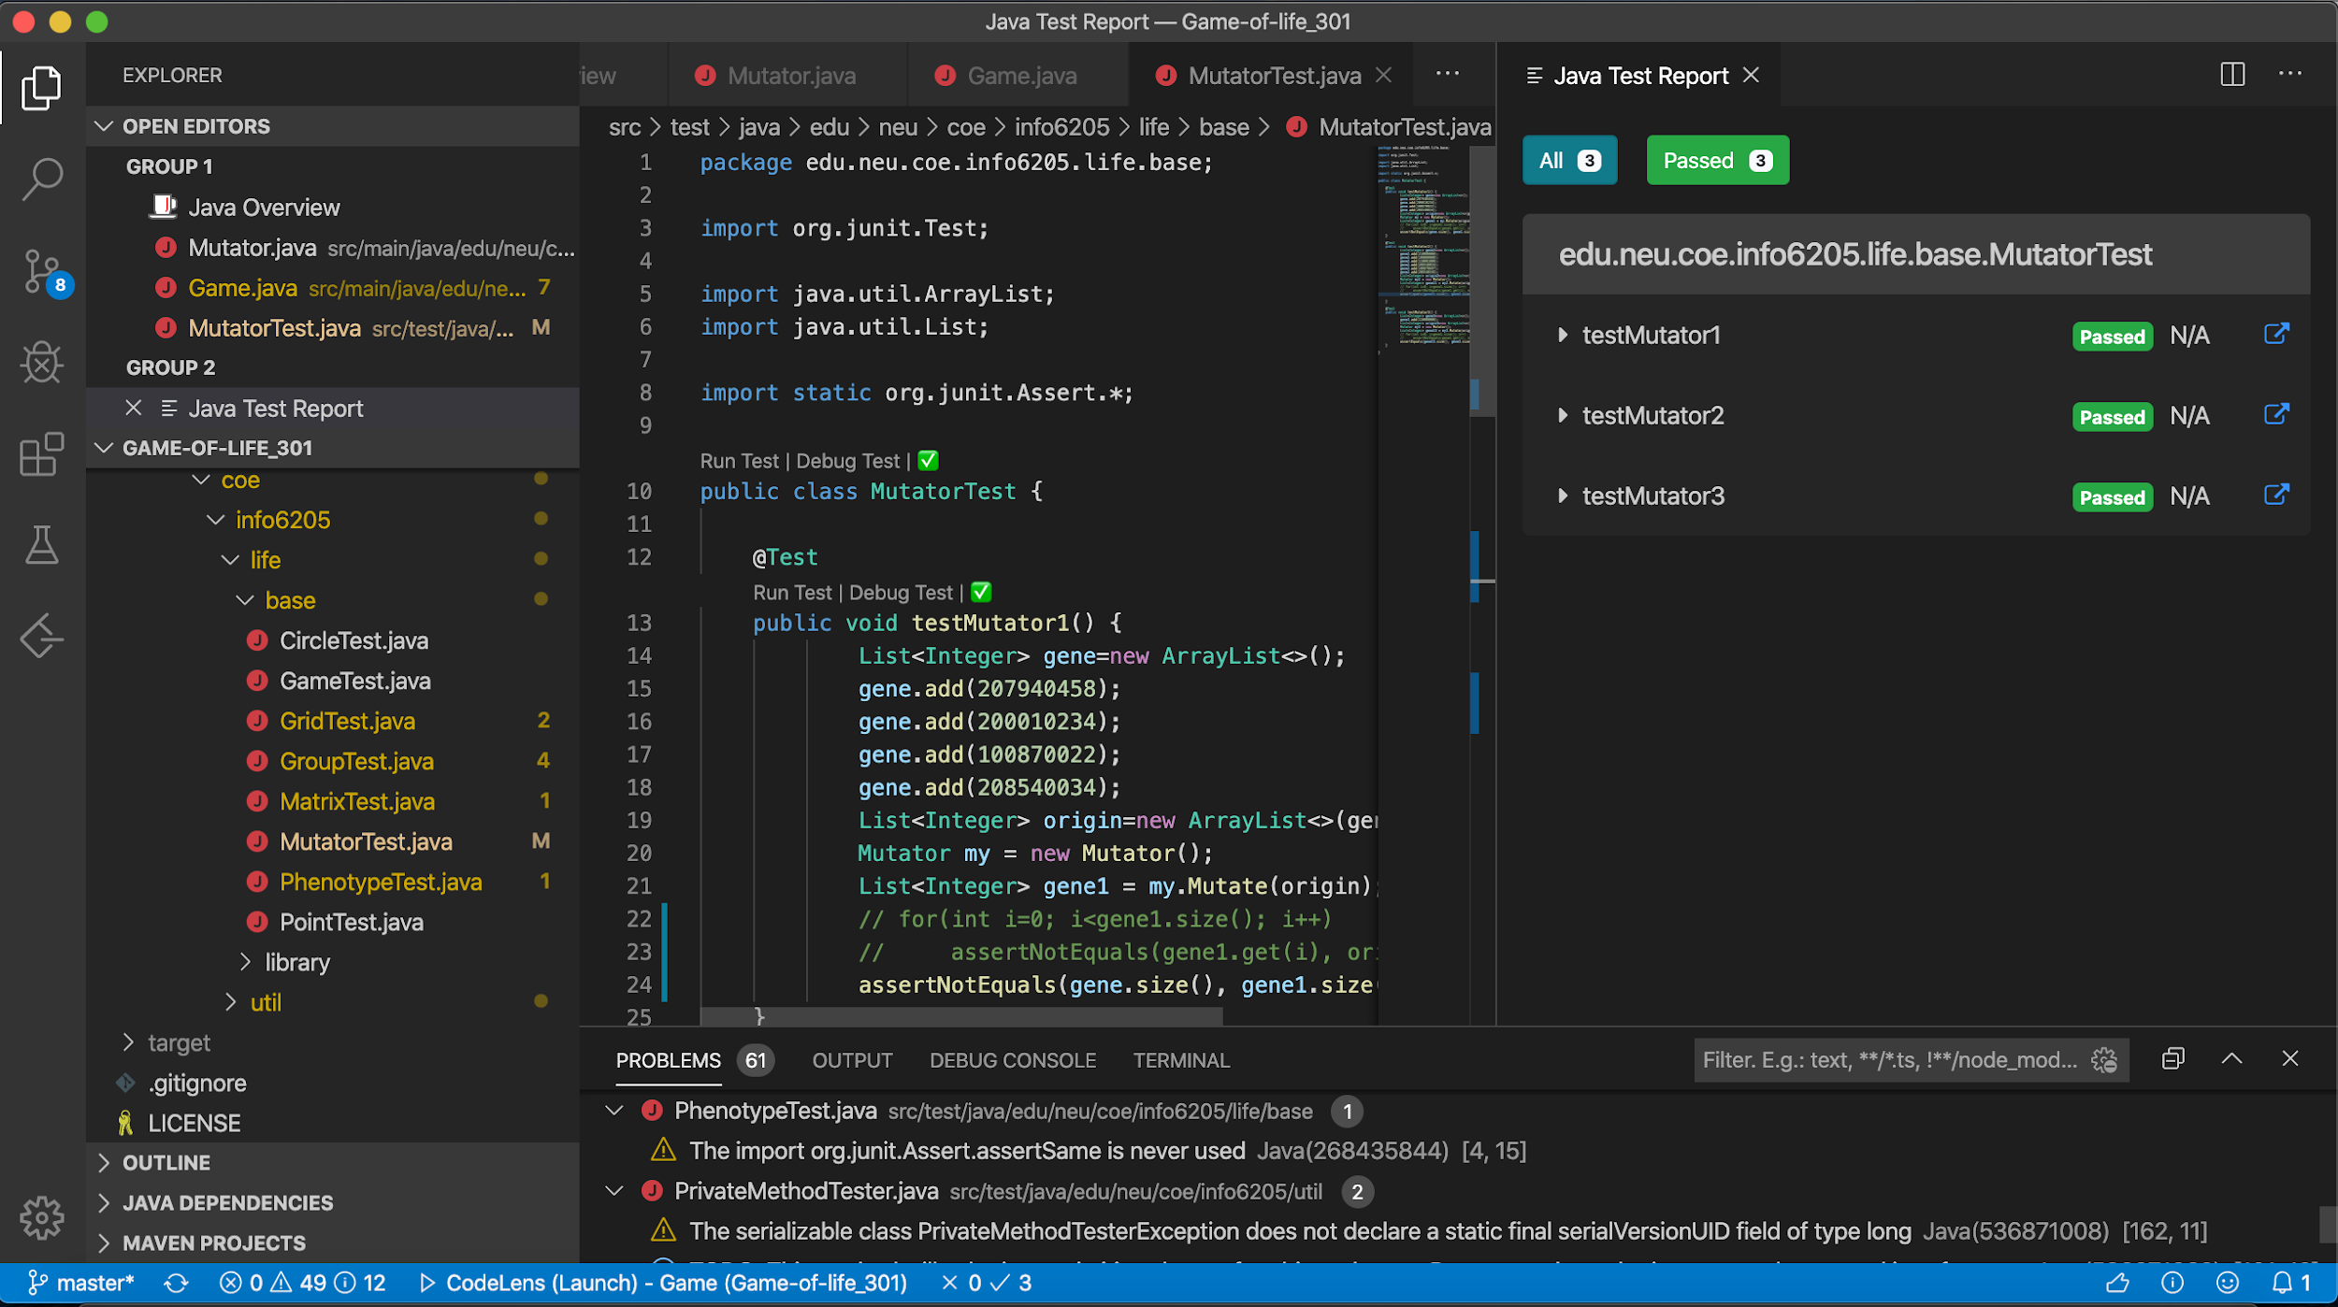
MutatorTest

Slide 15
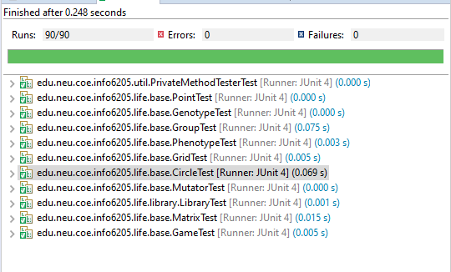
All test

Slide 16
Experiment
Algorithm Configuration
Seed: 1575766544173
Life game max generation: 2000
GA max generation : 40
GA population: 32
Select survive rate: 25%
Mutate add probability: 5%
Delete probability: 5%
Mutate move probability: 10%

Slide 17
Experiment
Population average growth rate data:
0.1621966963479648 ,0.18414928301385 ,0.1986241897123133 ,0.2073169366083308 ,0.23532308365409724 ,0.2538870967240999 ,0.2538870967240999 ,0.2538870967240999 ,0.2538870967240999 ,0.25973169058582846 ,0.25973169058582846 ,0.264261262594538 ,0.264261262594538 ,0.2672046800205846 ,0.2672046800205846 ,0.2672046800205846 ,0.2672046800205846 ,0.27389700305791836 ,0.27389700305791836 ,0.28520831306864664 ,0.2943717858871592 ,0.2943717858871592 ,0.2943717858871592 ,0.2943717858871592 ,0.2943717858871592 ,0.29482627169653713 ,0.29482627169653713 ,0.29702706370214205 ,0.2972002295303211 ,0.2972002295303211 ,0.2972002295303211 ,0.2972002295303211 ,0.2972002295303211 ,0.30844135720813237 ,0.30844135720813237 ,0.30844135720813237 ,0.30922006302365995 ,0.30922006302365995 ,0.30922006302365995 ,0.31204374021840553
Best Pattern:
living generation = 2000 average growth rate = 0.35421919553417197%

Slide 18
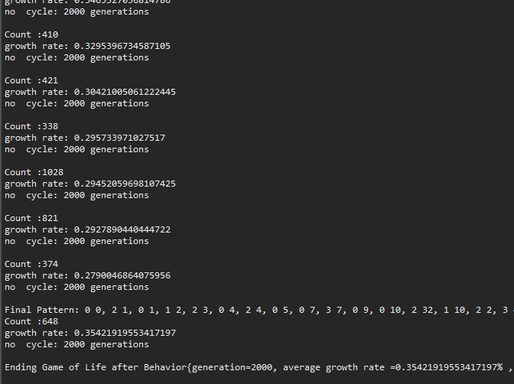
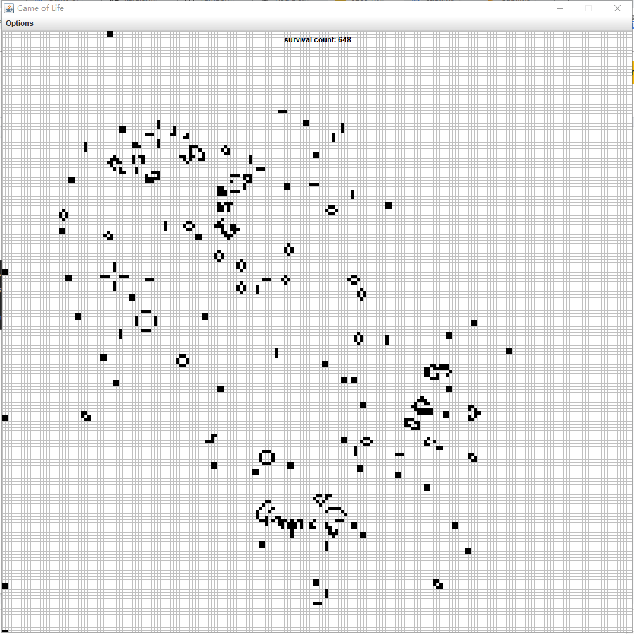
Result

Slide 19
Conclusion
We do find the best solution! Yeah!

